Slide 1
USING DATABASES
SESSION 1

Slide 2
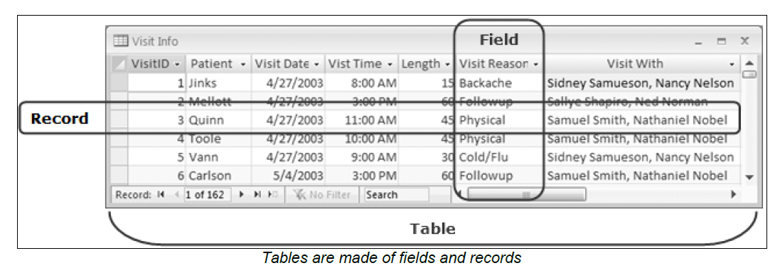
EXPLORING ACCESS
WORKING WITH ACCESS
A database is any collection of related data organised for fast search and retrieval. For example, a telephone book is a non-computerised database of information.
It is organised in alphabetical order and includes information such as names, addresses, and telephone numbers.
In Microsoft Access 2013, the database information is stored in data tables. Every data table has a structure that provides for the collection, organisation, storage, and retrieval of data.
These tables of information are contained in a database file. Each database file can have numerous data tables.

Slide 3
EXPLORING ACCESS
Access is a tool that you can use to quickly and easily develop relational database applications that help you manage information.
You can create a database to help you keep track of just about any kind of information, such as inventory, professional contacts, or business processes.
STARTING ACCESS
To start Microsoft Access
1.Select Start.
2. Point to All Programs.
3. Select Microsoft Office 2013.
4. Select Access 2013.

Slide 4
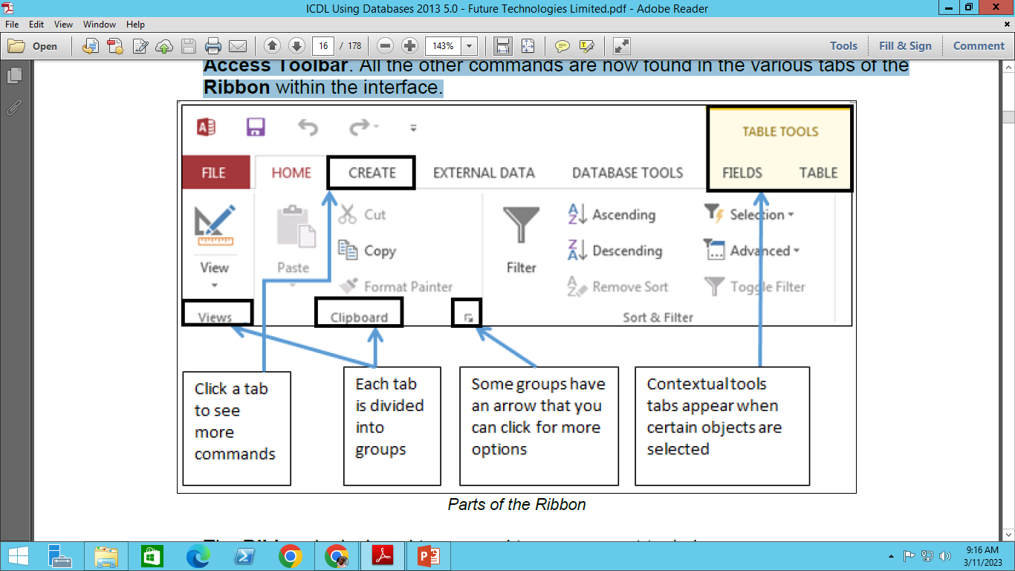
EXPLORING ACCESS
OPENING AN EXISTING DATABASE
Databases residing in your computer or on a shared network drive can be opened by starting Microsoft Access and then selecting Open command from the FILE tab.
FAMILIARISING WITH THE RIBBON
The Ribbon is the long strip comprised of tabs with buttons across the top of the main window within the Access interface.
The Ribbon is designed in a way that aids you in quickly finding commands that help complete a task, and contains almost all of the primary commands for working with access.
However, the FILE tab still exists, as does a single toolbar called the Quick Access Toolbar. All the other commands are now found in the various tabs of the Ribbon within the interface.

Slide 5
EXPLORING ACCESS
The Ribbon is designed to respond to your current task; however, you can choose to minimise the Ribbon if you find that it takes up too much screen space.
Click the arrow in the lower-right corner of the Ribbon to minimise it. Click a tab to make the Ribbon reappear. It will disappear again when not in use. To maximise the Ribbon, click a tab, then click the pin icon in the lower-right corner. The Ribbon will appear at all times.
USING THE CONTEXTUAL TABS
Contextual tabs appear on the Ribbon when an object requiring additional functionality is selected. For example, selecting a table in Access will display TABLE TOOLS contextual tabs on the Ribbon.
USING THE QUICK ACCESS TOOLBAR
By default, the Save, Undo, and Repeat/Redo buttons appear on the Quick Access Toolbar. If you regularly use a few buttons that are scattered on various tabs of the Ribbon and you do not want to switch between tabs to access the buttons or crowd the Ribbon with a custom tab, you might want to add these frequently used buttons to the Quick Access Toolbar.

Slide 6
EXPLORING ACCESS
UNDERSTANDING DATABASE OBJECTS
An Access database can contain various types of database objects, including tables, queries, forms, reports, macros and modules. The following section briefly introduces the four main database objects. All database objects can be accessed from the Navigation Pane.
Tables: The basic building block of any database is a table. A database table is similar in appearance to a list or spreadsheet, in that the data is stored in rows and columns
Queries: Queries allow users to locate data from one or more tables according to specific search criteria. The data you want to retrieve may be stored in several tables, and a query allows you to view data from several tables in a single datasheet
Forms: Forms are commonly used as data entry screens. They are user-friendly interfaces for working with data, and they often contain elements and command buttons that make entering data and performing various other tasks quick and easy.
Reports: You use reports to print and summarise data. Each report is formatted to present the information in the most readable way possible. You can format any report to fit your requirements and you can create custom reports as well.

Slide 7
EXPLORING ACCESS
To open a database object, in the Navigation Pane by double-clicking it. If you right-click an object, you notice a shortcut menu that lets you do various actions, such as opening an object in design view.
To delete a database object, You can delete any object (table, query, form, report) in the Navigation Pane by selecting it and pressing the Delete key. You can also click the Delete button on the HOME tab. Click Yes for the prompt.
SWITCHING BETWEEN THE VIEW MODES
As you continue working with Access, you will find yourself switching between Design view and Datasheet view. Click the View button on the Home tab to switch to the Design view of a table, query, form or report.
Note: Access allows you to configure several things on database start up. For instance, you can hide the Navigation Pane, launch a splash screen or a switchboard form, set an Application Title, set an Application Icon, and several other things. These settings can be set using the Access Options dialog box

Slide 8
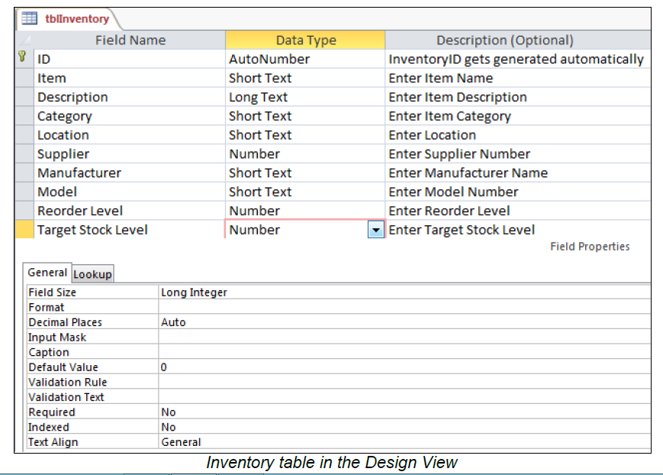
CREATING TABLES
USING DATABASE TEMPLATES
Access provides various templates that can be used to speed up your database creation process.
A template is a ready to use database that contains all of the tables, queries, forms, and reports needed for performing certain task.
ASSIGNING DATA TYPES
The field data type tells Access what kind of values you plan to store in a field and how much storage space to set aside for the field.
Although you can change a data type after a field contains data, doing so may erase some or all of the information in the field. The tblInventory table below in the Design view shows Field Name, Data Type and Properties:

Slide 9
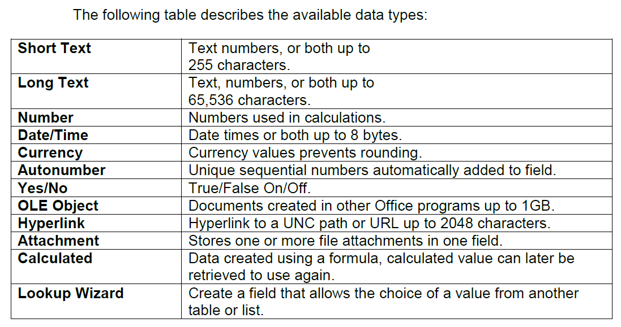
CREATING TABLES
The field data type tells Access what kind of values you plan to store in a field and how much storage space to set aside for the field. Although you can change a data type after a field contains data, doing so may erase some or all of the information in the field.
Tables are critical objects in a database because they hold all the information or data.
In Design view, you first create the structure of the new table. Then, you can either switch to Datasheet view to enter data or you can also use a form to enter data.
Design view also allows you to specify the field name, data type and additional information for each field in the Description column.

Slide 10
CREATING TABLES
Add field names in Design view.
If necessary, create a new table in Design view and select the first blank cell in the Field Name column.
Save a new table.
1. Select the FILE tab on the Ribbon.
2. Type the desired table name.
3. Select OK.
You can use the Description column to provide information about individual table fields. The field Description is optional. It helps you describe the field and is also displayed in the status bar when you select the field on a form.

Slide 11
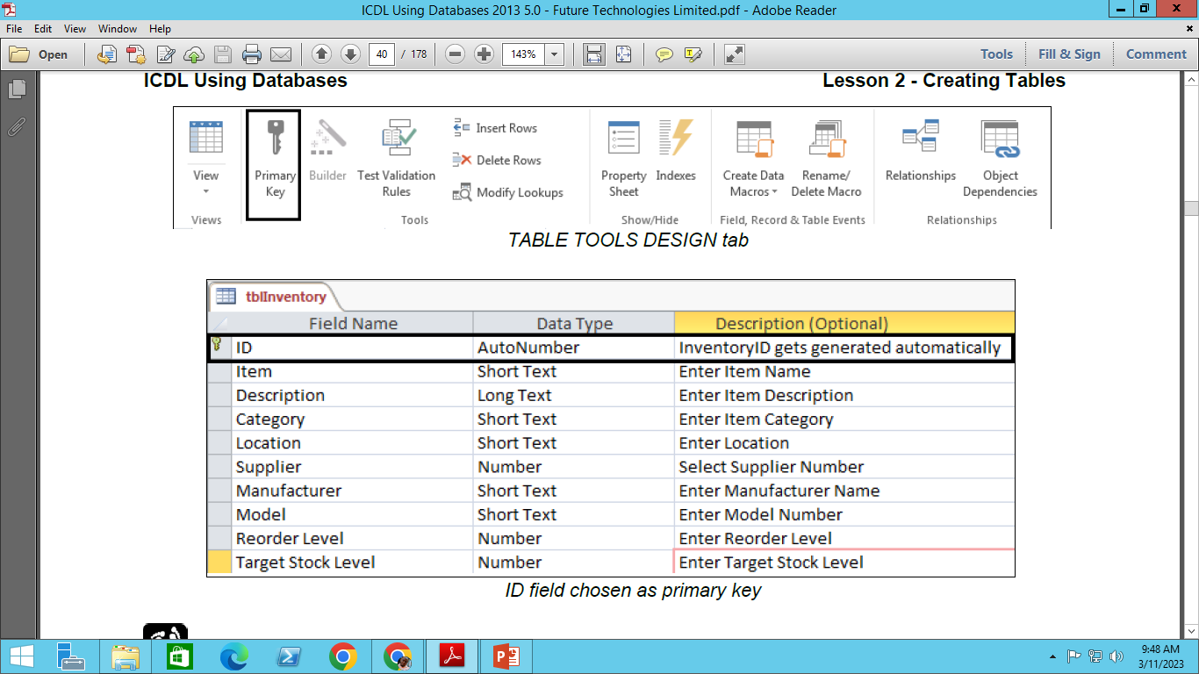
CREATING TABLES
SETTING A PRIMARY KEY
The primary key is a field in the table that uniquely identifies each record in the table. Examples of primary key include Order ID, Product ID, Customer ID or AutoNumber.
There are several advantages to setting a primary key.
First, the primary key is automatically indexed, which makes information retrieval faster.
Second, when you open a table, the records are automatically sorted in order by the primary key.
Finally, a primary key prevents the entry of duplicate data because Access does not allow duplicates in the primary key field.

Slide 12
CREATING TABLES
Set a field as the primary key.
1. Select the field you want to designate as the primary key.
2. Click the Primary Key button in the Tools group on the DESIGN tab on the ribbon.
When you create a new table and save it, Access can automatically create a primary key and assigns it the AutoNumber data type.
SETTING FIELD PROPERTIES
Each field has a set of properties that control the way it stores, handles, and displays data. Since forms and reports you create use the fields in your tables, setting field properties in the early stages of building a database can save you time later on; you will have less design work to do in later stages if you set the desired field properties before you create any forms and reports.
You normally set or change field properties when you create a table in Design view. If you have created and saved a table using default field properties, you can open the table in Design view to change its property settings.

Slide 13
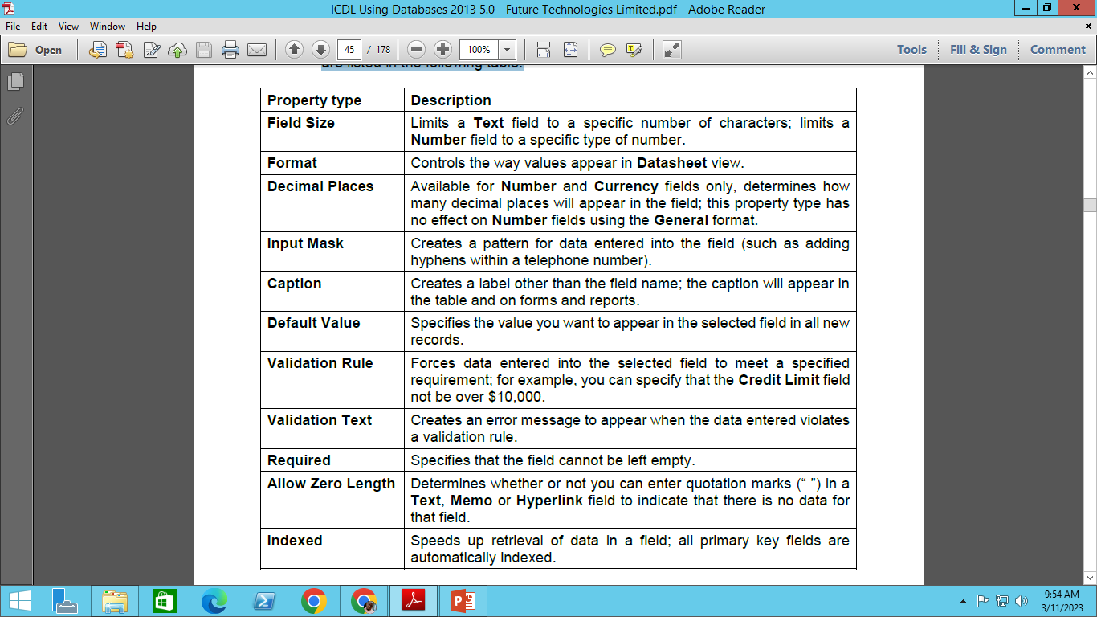
CREATING TABLES
Some of the property types you can set or change are listed in the following table:

Slide 14
CREATING TABLES
SETTING VALIDATION RULES
A validation rule ensures that only valid data is stored in the field. You can set validation rules for a field in the design view. When you enter data using the datasheet view or a form, the validation rules are applied before the data is saved in the table. If the data follows the rule, then it is saved in the table, otherwise it is not. If this occurs Access will display the validation text to notify the user that the entered data is not following the validation rule.
INDEXING A FIELD
Access uses indexes much like a Table of Contents to help locate and sort information quickly. An index is a copy of a field which is sorted and stored separately to speed up access to the data in a table.
LIMITING FIELD SIZE
Setting a field size limits the number of characters or the type of characters you can enter into a field. After typing the maximum number of characters allowed, further keystrokes are not permitted. The Field Size property is available only for Text, Number, and AutoNumber data types; all other data types have default sizes that are set automatically.

Slide 15
THANK YOU !!!
JONATHAN WALLAS

